Slide 1
Radiated Two Stage Method:
Fundamentals and Recent Process
PRESENTED BY Yihong Qi & Wei Yu
Advisors to AeroGT Labs
Notes:
Background Source: https://www.freepik.com/free-photo/traffic-light-trails_1175172.htm#term=night traffic&page=2&position=12

Slide 2

CONTENTS
Why MIMO OTA Test
Standard MIMO OTA Test Methods
RTS Theory Foundations
Two Key Techniques In The RTS Process
Advantages of The RTS Method
New Chamber for MIMO OTA Test

Slide 3

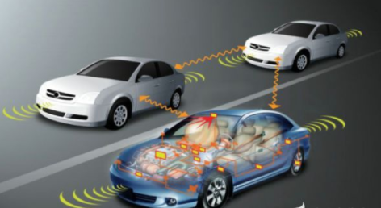


MIMO Applications
MIMO technique is becoming the mainstream of future communications.
How lab test results to reflect true end user experience in real life?

Slide 4
Why MIMO OTA Test
MIMO OTA performance differs from the conducted antennas test results plus the conducted RF receivers test results.
The noise from the DUT can be coupled into the antennas and then fed into the receivers, which would greatly affect the receiver sensitivities.
Different from SISO, the throughput is the only metric of figure for the MIMO performance evaluations.

Slide 5
CONTENTS
Why MIMO OTA Test
Standard MIMO OTA Test Methods
RTS Theory Foundations
Two Key Techniques In The RTS Process
Advantages of The RTS Method
New Chamber for MIMO OTA Test

Slide 6
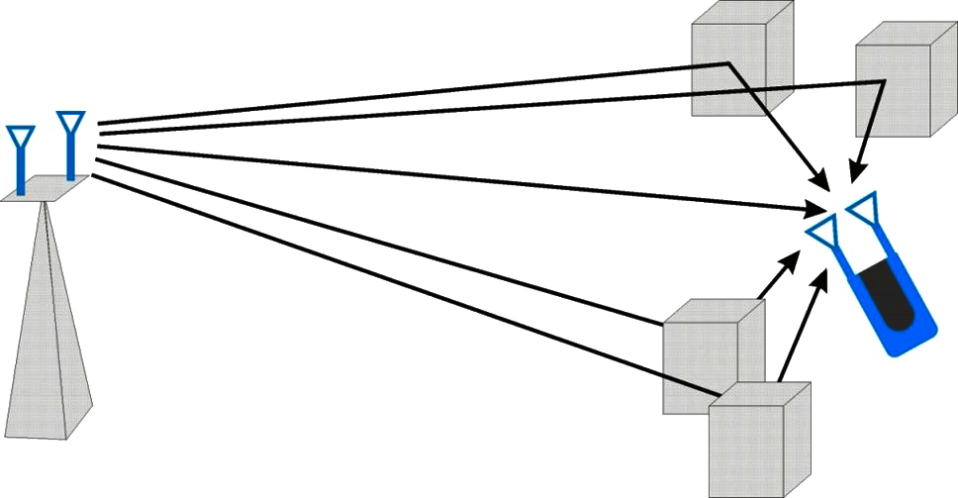
MIMO Test: Propagation Model Matters
Tx0
Tx1
MIMO throughput is a function of
  Number of antennas
  SIR/SNR
  Correlated channel matrix (channel model + antenna behaviors)
Designed to take advantages of more complex channel characteristics, the channel modeling required to emulate the radio environment for testing becomes both more critical and more complex
To ensure that measurements in the lab accurately correlate to the quality of the user’s experience, channel models must account for all the aspects of the radio environment, e.g. angles of departure, angles of arrival and angle spreads, XPR etc.
LOS
Rx1
Rx0
MS/UE
BS

Slide 7
MIMO Test: All About Channel Model
SCME Urban Macro-Cell
Cluster # | Delay [ns] |  |  | Power [dB] |  |  | AoD [°] | AoA [°]
1 | 0 | 5 | 10 | -3 | -5.2 | -7 | 82 | 66
2 | 360 | 365 | 370 | -5.2 | -7.4 | -9.2 | 81 | 46
3 | 255 | 260 | 265 | -4.7 | -6.9 | -8.7 | 80 | 143
4 | 1040 | 1045 | 1050 | -8.2 | -10.4 | -12.2 | 99 | 33
5 | 2730 | 2735 | 2740 | -12.1 | -14.3 | -16.1 | 102 | -91
6 | 4600 | 4605 | 4610 | -15.5 | -17.7 | -19.5 | 107 | -19
Delay spread [ns] |  |  |  |  |  |  |  | 839.5
Cluster AS AoD / AS AoA [°] |  |  |  |  |  |  |  | 2 / 35
Cluster PAS shape |  |  |  |  |  |  |  | Laplacian
Total AS AoD / AS AoA [°] |  |  |  |  |  |  |  | 7.8 / 62.6
Mobile speed [km/h] / Direction of travel [°] |  |  |  |  |  |  |  | 3, 30 / 120
XPR NOTE: V & H components based on assumed BS antennas |  |  |  |  |  |  |  | 9 dB
Mid-paths Share Cluster parameter values for: |  |  |  |  |  |  |  | AoD, , XPR
Tx0
Tx1
LOS
Rx1
Rx0
MS/UE
BS
TYPICAL
MATHEMATICAL
SCME channel models are the standards defined in the 3GPP and CTIA.

Slide 8
Standard Test Method: RC (or RC + CE) Method
Reverberation chamber (RC) or RC plus Channel Emulator (CE) method is based on statistics.
No standard models can be emulated accurately.
The results are not comparable with MPAC method and RTS method.

Slide 9
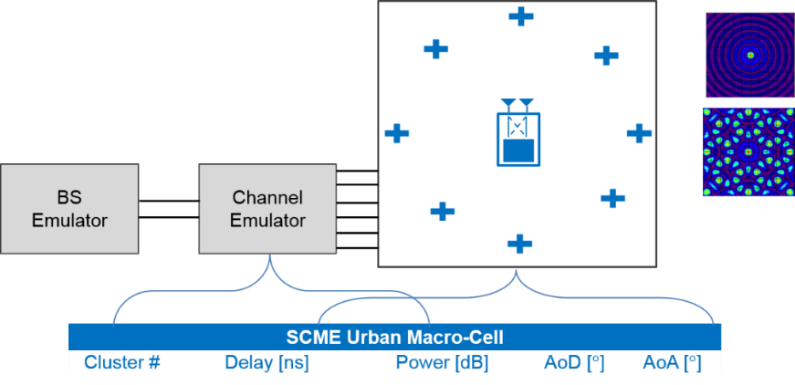
Standard Test Method: MPAC Method
Multiple Probe Anechoic Chamber (MPAC) method uses hardware enabled environment to simulate mathematical multipath environment.
Tx0
Tx1
LOS
Rx1
Rx0
MS/UE
BS
Half of the channel model are simulated in the channel emulator and half in the chamber hardware.

Slide 10



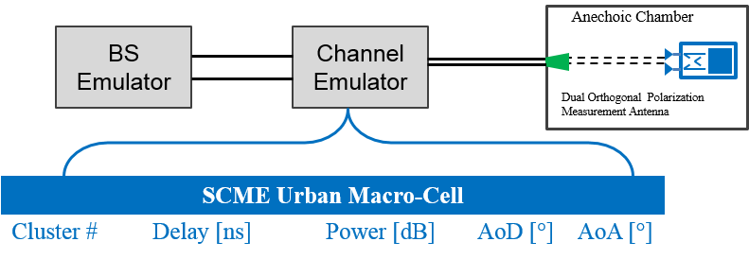
Standard Test Method: RTS Method
Radiated Two Stage (RTS) method integrates the antenna patters and the channel model through calculations and measures the throughput
All of the channel model are simulated in the channel emulator.

Slide 11
Summary of the Different Methods (2X2 MIMO)
 | MPAC | RTS | RC | RC+CE
#Channel emulator | 32 (more for large test zone) | 4 | 0 | 8
Device size | 0.8lamda | No limit if far field | Seems no limit | Seems no limit
Chamber size | huge | small | small | small
MIMO OTA Chamber support SISO OTA | Yes (need additional ring for SISO test) | Yes | Yes | Yes
Reuse existing SISO OTA chamber | No | Yes | Not sure | Not sure
Directional channel emulation | Yes | Yes | No | No
3D directional channel model | Yes (expensive channel emulator upgrade) | Yes | No | No
Device test support | No | Yes | No | No
Intermediate results for R&D | No | Yes | No | No
CA support | Yes (expensive channel emulator upgrade) | Yes (cost effective BS upgrade) | Yes | Yes (relative cost effective channel emulator upgrade)
Overall cost | $$$$$$ | $ | $ | $$

Slide 12
CONTENTS
Why MIMO OTA Test
Standard MIMO OTA Test Methods
RTS Theory Foundations
Two Key Techniques In The RTS Process
Advantages of The RTS Method
New Chamber for MIMO OTA Test

Slide 13
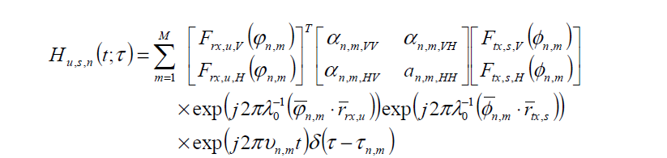
Conducted Two Stage Method
The Conducted Two Stage (CTS) method is presented by Keysight in 2009.
Cables
Channel
Emulator
SCME Urban Macro-Cell
Cluster # | Delay [ns] | Power [dB] | AoD [°] | AoA [°]

Slide 14
The Problem of The CTS Method
The CTS method was mainly challenged by two points.
  The noise generated by the UE can be coupled to the UE antennas and then fed into the receivers, which will decrease the sensitivity.
  The inconvenience of connecting cables to the DUT makes it hard to calibrated the cables pass loss.

Slide 15
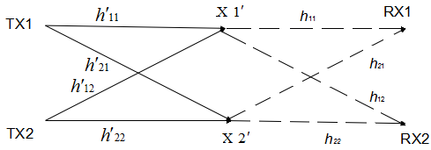
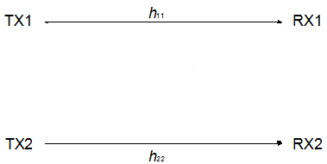
From Conducted to Radiated
Simple But Creative
The inverse matrix
The propagation matrix in chamber
CE
CE
= H*
=
* H *
H=
=

Slide 16
RTS Method
Measure the complex DUT antenna patterns.
Search the inverse matrix of the propagation matrix.
Combine the antenna pattern information, the channel model, the inverse matrix in the instruments.
Measure the throughput in the chamber.

Slide 17
CONTENTS
Why MIMO OTA Test
Standard MIMO OTA Test Methods
RTS Theory Foundations
Two Key Techniques In The RTS Process
Advantages of The RTS Method
New Chamber for MIMO OTA Test

Slide 18
First One: Inverse Matrix Searching
How to solving the inverse matrix IM.
Making the CTS method being the RTS method

Slide 19
Calibration Matrix Definition
Calibration Matrix
calibration matrix
gains of test antennas
gains of DUT antennas
free-space propagation
phase offsets between BTx and Sx
Unknown parameters

Slide 20

Definition of Isolation
With the inverse matrix applied, in the practical application of the RTS method, the cross-talking is always existent.
We define the “virtual cables” as showed in the figure.
The isolation of the virtual cables is defined as:
Experiments show that isolation should be larger than 15dB to ensure the throughput test accuracy.
$$\begin{matrix}{Iso}_{1}=\left|{P_{11}}/{P_{12}}\right| \\ {Iso}_{2}=\left|{P_{22}}/{P_{21}}\right| \\ Iso=min⁡({Iso}_{1},{Iso}_{2})\end{matrix}$$
Inverse Matrix Applied

Slide 21
Inverse Matrix Auto Tuning Method
1. The inverse matrix auto searching and tuning method.
  Select an appropriate combinations of measurement antennas and DUT orientation for inverse matrix solving, which can ensure the isolation large enough (generally >= 15dB).
  Tune the inverse matrix at the selected combination of measurement antennas and DUT location.
2. The advantages of the inverse matrix auto solving method.
  Just several minutes are required for the inverse matrix searching and tuning.
  An appropriate combinations of measurement antennas and DUT orientation can be obtained which can ensure the largest isolation.

Slide 22
Second One: RSARP Error Elimination
Stage 1: Measure the complex antenna patterns.
Stage 2: Measure the throughput.
The antenna patterns are achieved through RSARP reporting system.
A typical RSARP reporting system has an error of 2dB for power evaluation and an error of 10 degrees for phase evaluation.

Slide 23
RSARP Reporting Errors Eliminating Method
With errors
Improved method without errors
Achieve the propagation matrix (the calibration matrix through RSARP reporting).
Solve the inverse matrix of the obtained calibration matrix.

Slide 24
CONTENTS
Why MIMO OTA Test
Standard MIMO OTA Test Methods
RTS Theory Foundations
Two Key Techniques In The RTS Process
Advantages of The RTS Method
New Chamber for MIMO OTA Test

Slide 25

The Problem
What is the chief concern for engineers, if their MIMO wireless devices fail to pass the network measurements?
How to detect the imperfections and debug the RF designs for the MIMO terminals?

Slide 26
The Solutions
ECC (envelope correlation coefficient)
A. The antenna system
Antenna patterns
Antenna gain
Antenna imbalance
Radiated sensitivities (both receivers)
B. The receiver system
TIS values
C. Desense
Noise levels at both receiver inputs

Slide 27
RTS Based Decomposing Test Procedure
Measure the MIMO DUT complex antenna patterns.
Calculate the inverse matrix of the calibration matrix.
With the inverse matrix applied, measure the radiated sensitivities of the two receivers in normal mode, respectively.
Measure the radiated sensitivities of the two receivers separately, in the SNR test mode.
Measure the throughput.
RTS test system

Slide 28
Notes
Normal Working Mode:
Adjust the downlink power step by step until reaching the threshold BER.
SNR Working Mode:
Keep the downlink power fixed and adjust the noise level step by step until reaching the threshold BER.

Slide 29
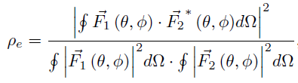

Decomposition Test Results: Antenna System
The antenna gains, imbalance and ECC can be calculated though the measured complex patterns.
Especially, ECC, a number between 0 and 1, is:
where
Complex field vectors
Measured antenna gains
Measured relative phase

Slide 30
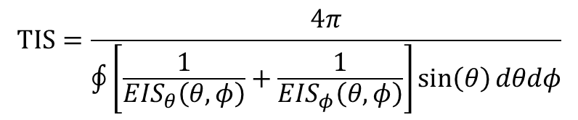
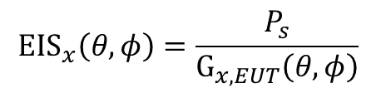
Decomposition Test Results: RF Receivers
The radiated sensitivities are measured in step 3, and the antenna gains are measured in step 1.
TIS can be expressed as
$$TIS=\frac{4π}{\oint{\left[\frac{1}{{EIS}_{θ}\left(θ,φ\right)}+\frac{1}{{EIS}_{φ}\left(θ,φ\right)}\right]\sin\left(θ\right)dθdφ}}$$
$${EIS}_{x}\left(θ,φ\right)=\frac{P_{s}}{G_{x,EUT}\left(θ,φ\right)}$$
where
EIS values in different polarizations
Measured antenna gains
Radiated sensitivity (measured in normal working mode)

Slide 31

Decomposition Test Results: RF Receivers
The noise levels at both receivers can be obtained as follow.
Radiated sensitivity (measured in normal working mode)
Radiated sensitivity (measured in SNR working mode)
$$\frac{P_{s}}{N_{s}}=\frac{P_{ns}}{N_{ns}+N_{s}}$$
Noise level Ns can be calculated.
Noise level (in normal mode, unknown)
Noise level (in SNR working mode, known)

Slide 32
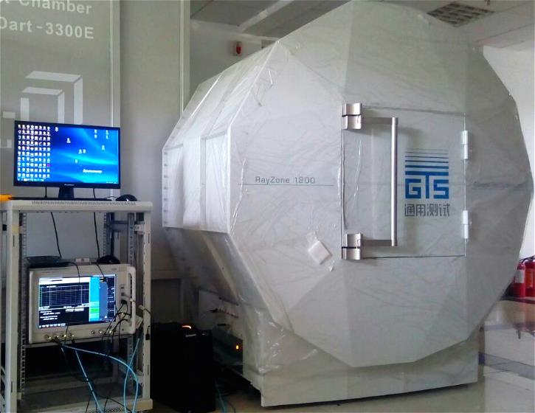
Experiments
Keysight UXM + GTS1800 solution for 2 by 2 MIMO OTA test.

Slide 33
Test Procedure
Measure the MIMO DUT complex antenna patterns.
Calculate the inverse matrix of the calibration matrix.
With the inverse matrix applied, measure the radiated sensitivities of the two receivers in normal mode, respectively.
Measure the radiated sensitivities of the two receivers separately, in the SNR test mode.
Measure the throughput.
Notes:
For clear exhibitions on how the noise does influence the radiated sensitivity and the final throughput results, contrast experiments were conducted with the DUT’s digital camera on and off (in other words, the digital camera is used as an interference source).

Slide 34
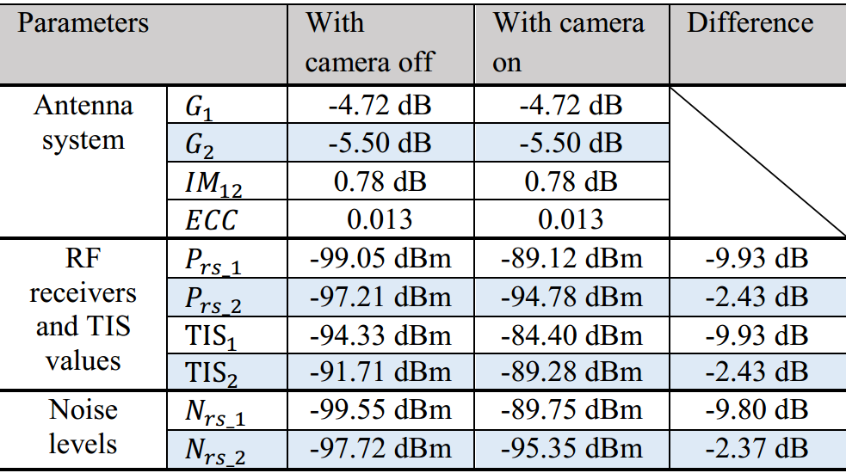
Results

Slide 35
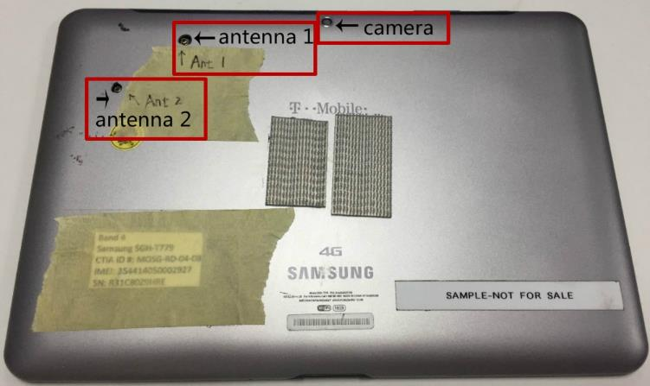
Analysis
The desense brought by the camera circuit could cause a significant degradation (about 6.8 dB) on the throughput test.
The camera circuit could cause a larger radiated sensitivity degradation for receiver 1 (9.93 dB) than receiver 2 (2.43 dB).

Slide 36
CONTENTS
Why MIMO OTA Test
Standard MIMO OTA Test Methods
RTS Theory Foundations
Two Key Techniques In The RTS Process
Advantages of The RTS Method
New Chamber for MIMO OTA Test

Slide 37
Test Zone: Defined by CTIA
Ripple test in Phi axis
Ripple tests.
SSD < 0.7 (generally for certification chamber).

Slide 38
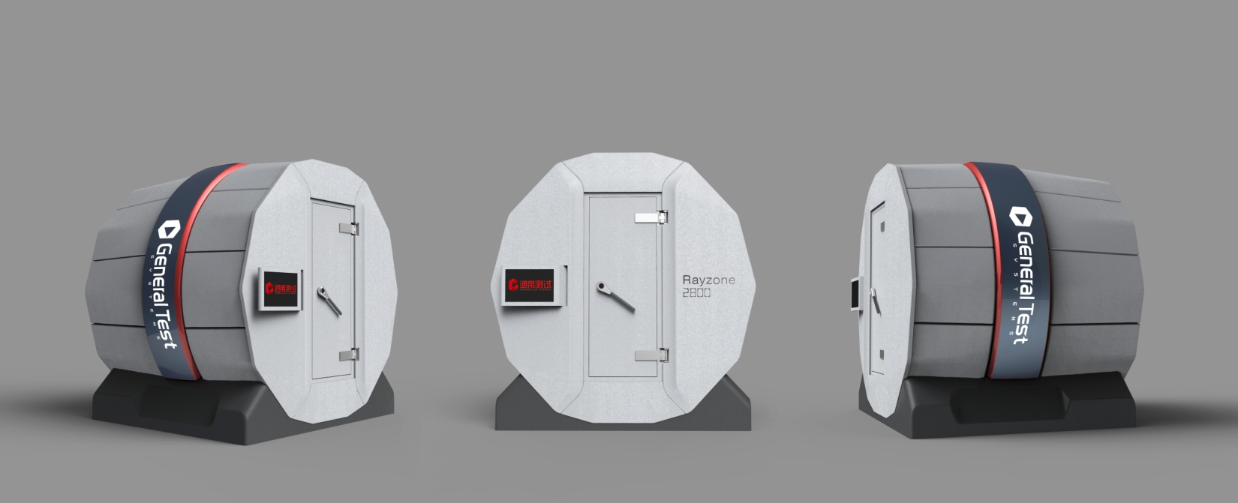
GTS New Chamber for OTA
Full Function: 2G/3G/4G, GPS/A-GPS, BeiDou, Wi-Fi, Bluetooth
SISO
True 3D MIMO 2×2, 4×4
Antenna Measurement, Full Band Fast Sensitivity Sweep
Certified Level of Accuracy
Compact, Fast, Accurate, Easy to Install and Reassemble
Size (L×W×H) | 3m × 3m × 2.9 m
Quiet Zone (QZ) | Φ30 cm
Reflection Level (in QZ) | < -32 dB (measured)
Shielding Effect | >90 dB (600MHz - 6GHz)
Measurement Path | 0.95 m

Slide 39
Test Zone: Measurement for 2800
Ripple tests for MA6 antenna are according to the CTIA test plan.
Ripple tests for other antennas are based on the Line-Movement method, where we move the antenna step by step along a line and calculate the SSD.
Ripple test in Phi axis
The SSD in 2800 < 0.28 (for more smaller than 0.7)!

Slide 40
Test Zone: Definition by CTIA for SISO Chamber
Ripple tests.
SSD < 0.6 (generally).
Ripple test in Phi axis
The accuracy of the antenna gains in the weak directions almost have no influence on SISO tests.

Slide 41
Additional Slides

Slide 42
CONTENTS
GTS OTA Solutions Overview
MIMO OTA Test Methods Introduction
Inverse Matrix Solving
RTS Based Decomposing Test
Test Zone in MIMO OTA Test Chamber
RTS Recent Process

Slide 43
Test Zone: New Definition for MIMO
The channel model has standards of power level distribution.
The major test challenge for MIMO OTA test is how to create the test environment.
The accuracy of the antenna gains in the weak directions may have large influence on throughput tests.
Tx0
Tx1
LOS
Rx1
Rx0
MS/UE
BS
SCME Urban micro-cell
Cluster # | Delay [ns] |  |  | Power [dB] |  |  | AoD [°] | AoA [°]
1 | 0 | 5 | 10 | -3.0 | -5.2 | -7.0 | 6.6 | 0.7
2 | 285 | 290 | 295 | -4.3 | -6.5 | -8.3 | 14.1 | -13.2
3 | 205 | 210 | 215 | -5.7 | -7.9 | -9.7 | 50.8 | 146.1
4 | 660 | 665 | 670 | -7.3 | -9.5 | -11.3 | 38.4 | -30.5
5 | 805 | 810 | 815 | -9.0 | -11.2 | -13.0 | 6.7 | -11.4
6 | 925 | 930 | 935 | -11.4 | -13.6 | -15.4 | 40.3 | -1.1
The reflection is used as the new figure-of-merit to evaluate the test zone of MIMO OTA test chambers.

Slide 44
Test Zone Evaluation Method for MIMO
Reflection Power Measurements
Move the DUT along the axis (a step of 2cm is recommended) and record the received power (or RSSI).
Calculate the reflection levels through the test ripples with the absolute path-loss (simulated by PC) calibrated out.

Slide 45
Test Zone Evaluation Results for MIMO
Experiments show that at least -27dB of the reflection is required for the MIMO OTA test chambers (the influence on the throughput test can be neglect-able).
-30dB is the measurement limit, since
  For dipole test, the factor including the gain, the common mode current, the VSWR and the efficient antenna aperture are unknown and can not be calibrated out.
  For RSSI test, the RSSI reporting error is larger than ±0.2dB (±0.1dB for the data truncation, ±0.1dB for the power measurement in the receiver)
In summary, at least -27dB of the reflection level is required for the MIMO OTA test, and this can be measured through the discussed two methods.

Slide 46

Rayzone 2800 Chamber for MIMO
Size (L×W×H) | 3m × 3m × 2.9 m
Quiet Zone (QZ) | Φ30 cm
Reflection Level (in QZ) | < -40 dB (simulated)
Reflection Level (in QZ) | < -32 dB (measured)
Antenna Pattern Accuracy | ±0.1 dB
Probe Antenna Coupling | < -40 dB
Turn Table Max Load | 20 kg
Turn Table Max Speed | 40°/s
φ-Resolution | 0.5°
θ-Resolution | 15°
Door (H×W) | 1900mm × 700mm
Shielding Effect | >90 dB (600MHz - 6GHz)
Measurement Path | 1 m
Number of Antennas | 2×11+1
RF Interfaces | 4 SMA In/Out, 1 calibration
Power | AC 220/110 V
Control Interface | RS 232
Hardware Structure | On-site Assembly & Reassembly

Slide 47
Test Zone Validations for 2800 (dipole)
90V antenna.
-36 dB is obtained by using the calculating method.
-32 dB is obtained by using the simulating method.

Slide 48
Test Zone Validations for 2800 (dipole)
90V antenna.
-36 dB is obtained by using the calculating method.
-32 dB is obtained by using the simulating method.

Slide 49
CONTENTS
GTS OTA Solutions Overview
MIMO OTA Test Methods Introduction
Inverse Matrix Solving
RTS Based Decomposing Test
Test Zone in MIMO OTA Test Chamber
RTS Recent Process

Slide 50
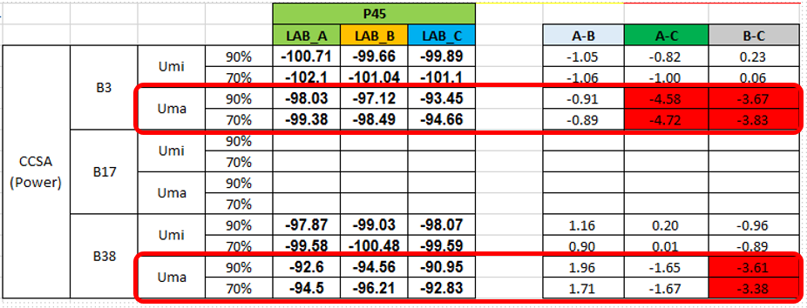
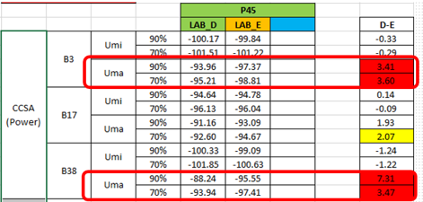
Part1：MPAC Accuracy (Proposed By HW)
 | MPAC | RTS
Chamber-to-chamber variation (UMa) | 7 dB * | 1 dB
Results Group 1 in Lab_A/B/C:
  Same system Vendor V1
  Same DUT1
Results Group 2 in Lab_D/E:
  Another system Vendor V2
  Another DUT2
*Data from Huawei submitted to CTIA, May, 2017.

Slide 51
Part2：MPAC VS RTS Comparisons
Phone xxxx |  |  |  | UMi |  |  | Difference
 |  |  |  | 70% | 90% | 95% | 70% | 90% | 95%
 | LTE B3 | P +45 | 2-stage | -100.18 | -97.88 | -96.70
 |  |  | MP | -100.31 | -98.55 | -97.78 | -0.13 | -0.67 | -1.08
 |  | L +45 | 2-stage | -99.03 | -97.3 | -96.02
 |  |  | MP | -99.09 | -97.52 | -96.74 | -0.06 | -0.22 | -0.72
 |  | P +90 | 2-stage | -96.17 | -94.08 | -93.35
 |  |  | MP | -96.51 | -94.74 | -93.87 | -0.34 | -0.66 | -0.52
 | LTE B7 | P +45 | 2-stage | -94.82 | -93.17 | -92.25
 |  |  | MP | -94.26 | -92.56 | -91.88 | 0.56 | 0.61 | 0.37
 |  | L +45 | 2-stage | -94.66 | -93.00 | -92.10
 |  |  | MP | -94.09 | -92.15 | -91.22 | 0.57 | 0.85 | 0.88
 |  | P +90 | 2-stage | -90.93 | -89.04 | -87.8
 |  |  | MP | -90.06 | -87.85 | -86.76 | 0.87 | 1.19 | 1.04
 | LTE B13 | P +45 | 2-stage | -92.34 | -90.98 | -90.36
 |  |  | MP | -92.66 | -91.32 | -90.78 | -0.32 | -0.34 | -0.42
 |  | L +45 | 2-stage | -90.66 | -89.4 | -88.74
 |  |  | MP | -90.19 | -88.88 | -88.43 | 0.47 | 0.52 | 0.31
 |  | P +90 | 2-stage | -89.17 | -87.88 | -87.23
 |  |  | MP | -89.13 | -87.82 | -87.40 | 0.04 | 0.06 | -0.17
 | LTE B5 | P +45 | 2-stage | -93.31 | -91.72 | -90.99
 |  |  | MP | -93.69 | -92.21 | -91.62 | -0.38 | -0.49 | -0.63
 |  | L +45 | 2-stage | -91.35 | -90.01 | -89.37
 |  |  | MP | -90.72 | -89.47 | -89.07 | 0.63 | 0.54 | 0.30
 |  | P +90 | 2-stage | -89.79 | -88.33 | -87.59
 |  |  | MP | -90.06 | -88.76 | -88.29 | -0.27 | -0.43 | -0.70

Slide 52
Part2：MPAC VS RTS Comparisons
Angel-wise throughput generally matches well between MPAC and RTS.
The largest angle-wise throughput difference is around 1.5 dB.
Angel-wise throughput generally matches well between MPAC and RTS.
The largest angle-wise throughput difference is around 0.8 dB.

Slide 53
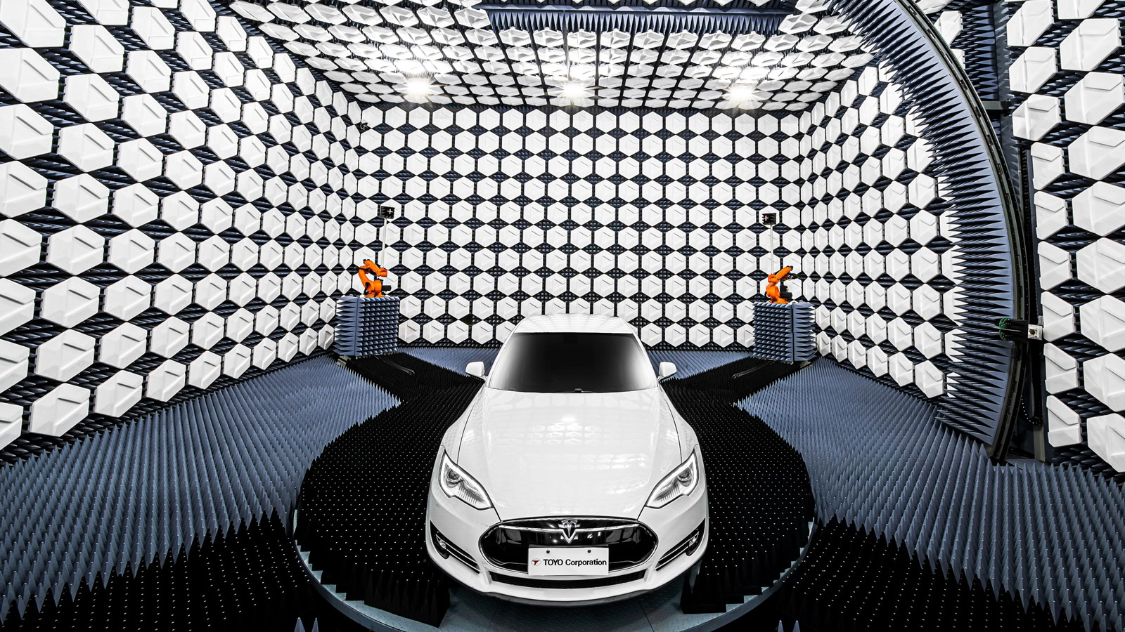



Slide 54
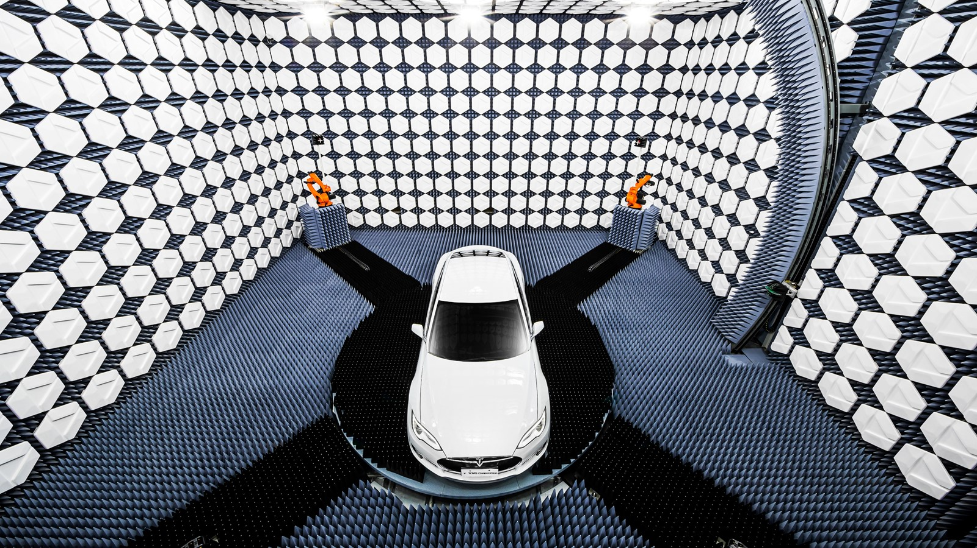
RESOURCES
Web: www.aerogtlabs.com
Linkedin: https://www.linkedin.com/company/aerogt-labs
Video: Next-Gen Automotive OTA Test: https://youtu.be/Gr1hojkvRmE
Contact: info@ aerogtlabs.com

