Slide 1
The Challenges of 5G MIMO
Measurements in a Vehicle
Bo Han
Bo.han@aerogtlabs.com
Notes:
Background Source: https://www.freepik.com/free-photo/traffic-light-trails_1175172.htm#term=night traffic&page=2&position=12

Slide 2

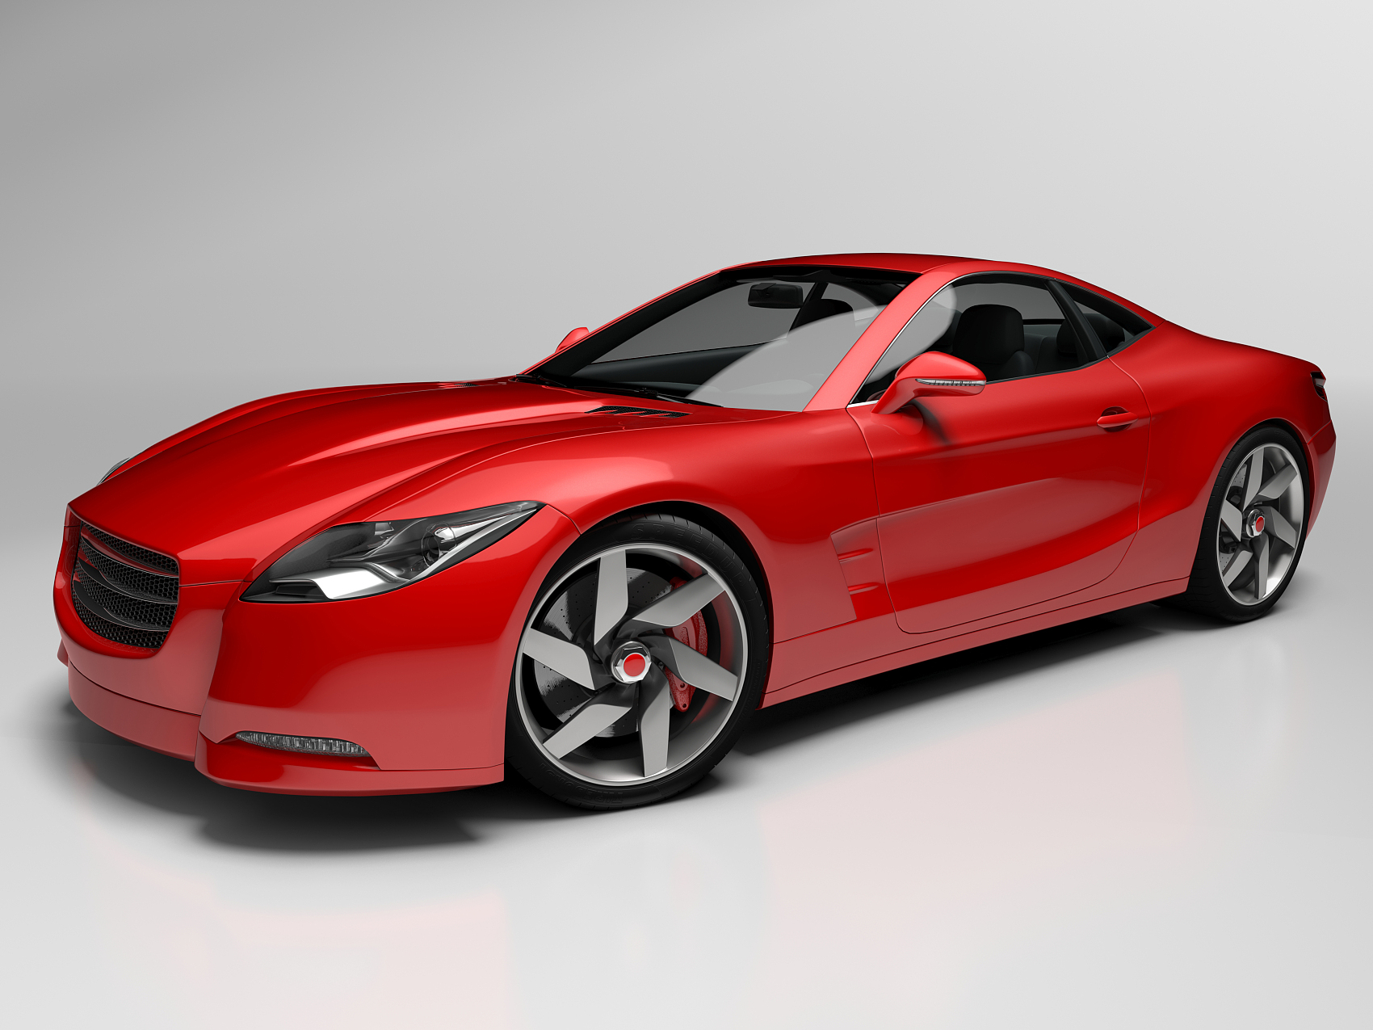
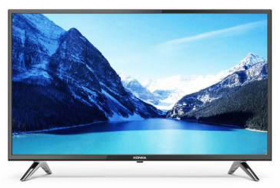

Focus on Wireless OTA Testing
Wireless UE/BS
Certification, R&D, Manufacturing
5G mmWave &Sub6GHz
Intelligent Connected Vehicle(ICV)
Smart Home
Smart TV, Smart Speaker
Indoor MIMO scenario
Full Vehicle OTA Testing
EMC-upgraded OTA Testing System
Custom Test System For Dedicated Applications
Satellite Internet
mmWave Phased Array Antenna
Satellite Antenna
Satellite Internet Device
High Performance mmWave CATR Large Spherical Near-field Test
Notes:
International Certification International Standard International Market
3GPP MIMO OTA test standard contributor and patent holder--Radiated Two-Stage (RTS method）；
CTIA MIMO OTA test standard contributor；
China 4G LTE MIMO OTA test standard co-proposer ；
Beidou UE wireless test standard co-proposer
CTIA certified testing system provider
China Mobile 5G wireless UE testing system--YuHeng integrator
51 Published patents, 121 pending patents
35 Core journal articles

Slide 3
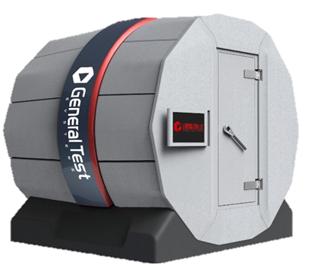
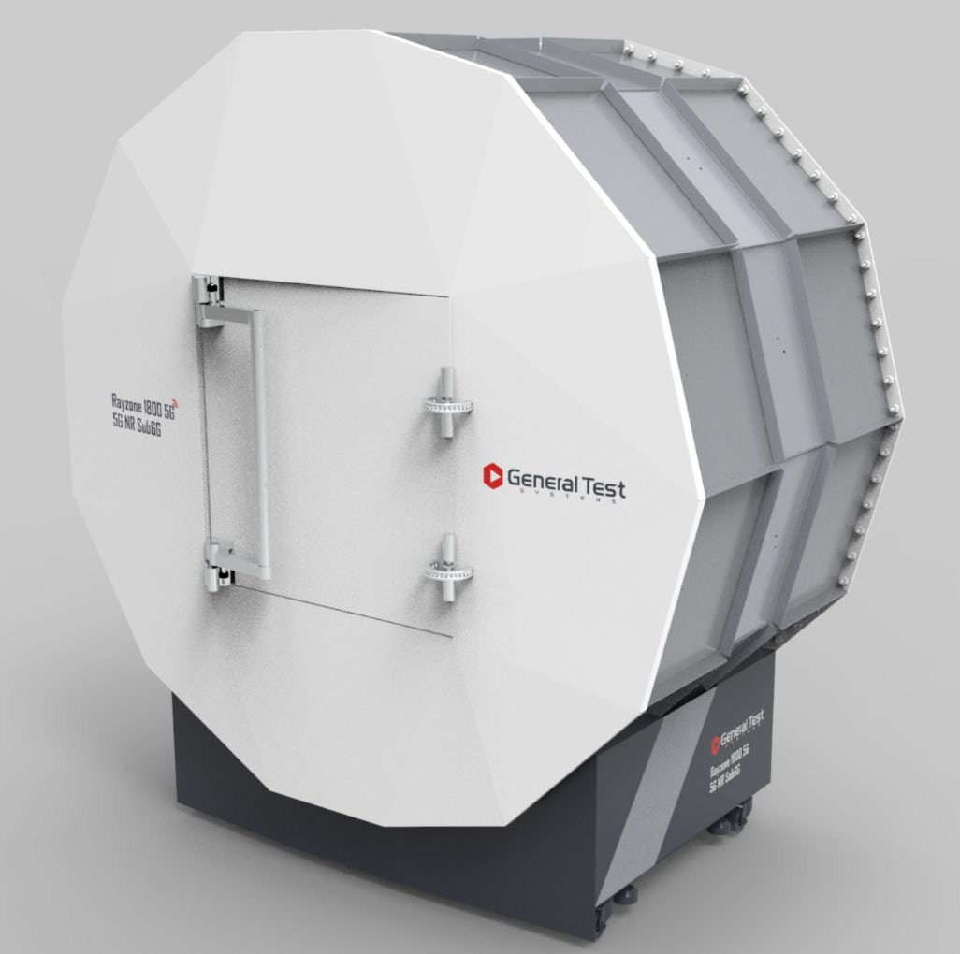
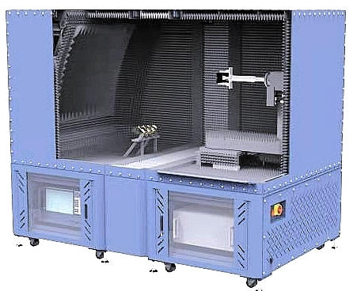
5G OTA Testing
Full coverage: UE, base station, wearables etc.
Wide applications: R&D, conformance, pre-conformance test, manufacturing test
For Antenna test/ SISO & MIMO OTA test
Different types: MPAC/CATR/Reverberance

Slide 4
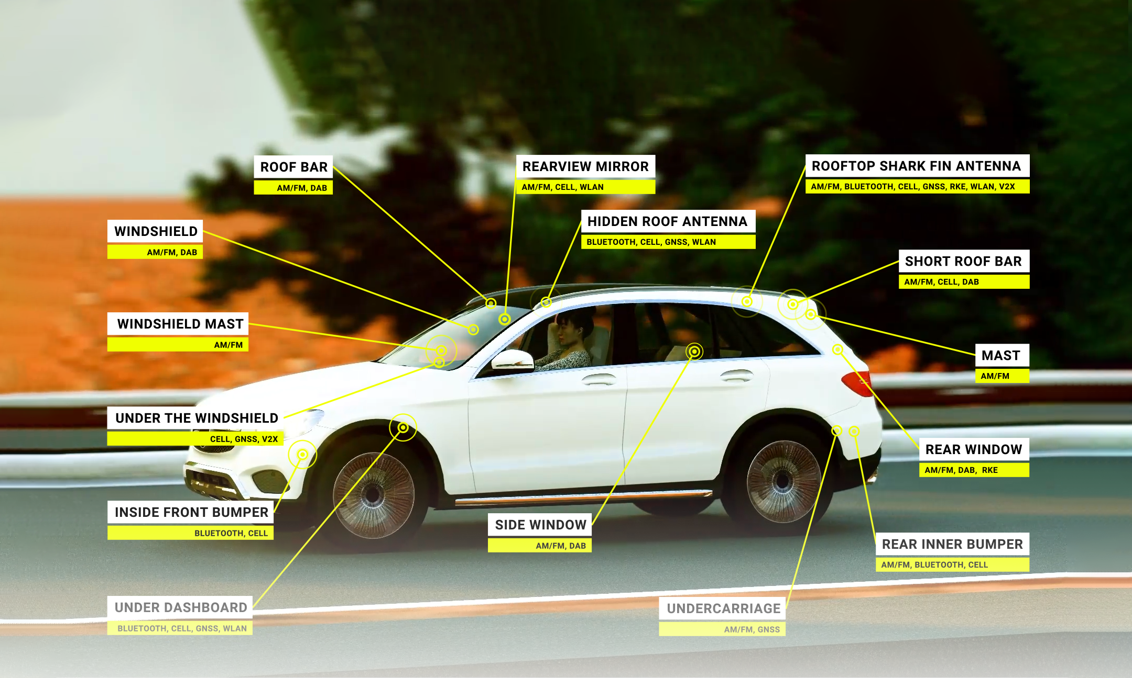

Slide 5


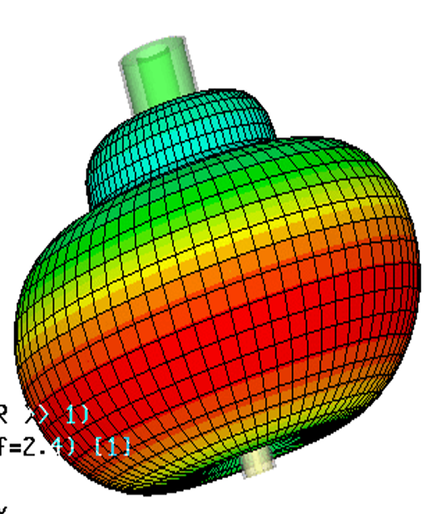
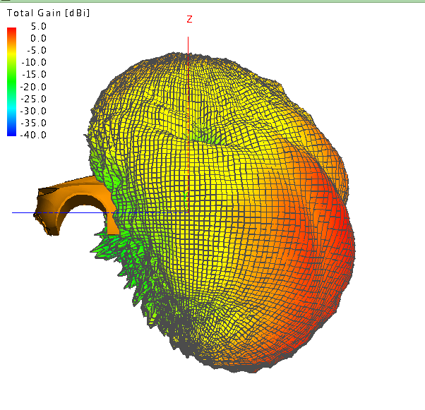
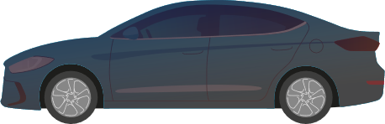
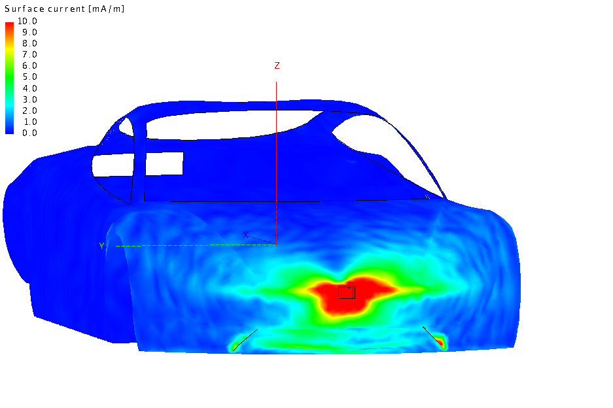



Why Full Vehicle OTA Measurements is Critical?
  Multiple antennas on car
  Noise &
  interference
A. Antennas
Radiated pattern
Antenna gain
  Evaluate performance in real environment
  Problem
  Diagnosis & system optimization
B. Transceiver
Throughput
TRP/TIS
C. EMC
Interference
Immunity
Notes:
Multiple antennas on car
The radiation performance of an entire
vehicle is very different from that of a single
antenna
The car exterior is also a source of radiation;
thus it is necessary to obtain a vehicle radiation
pattern through full vehicle test
Internal interference
The ICV will integrate multiple wireless communication modules, including A-GNSS/GNSS , 2 3 4 5G, V2X, AM/FM, and even ground wave communication and radio communication.
The simultaneous operation of the radio in the vehicle may cause great EMI issues.
Various high-power devices inside may be interference sources for wireless communication modules.
Propagation environment simulation
The influence of the complex propagation environment: the vehicle is always driving on the real world (with multiple-path). How to reflect the ICV wireless performance in the multipath environment via measurement in chamber?
How to perform MIMO OTA test of ICV?
It is extremely challenging to simulate the
testing of a moving vehicle in the real world (with multiple-path) in an EMC chamber – few can do this – and even fewer can do this with speed and precision
System diagnosis
If the overall performance does not meet the requirements, how to find the imperfection?
The radiation pattern, antenna gain, efficiency, etc. can be obtained from the antenna test results
Receiver sensitivity can be obtained from the receiver test (SISO OTA performance)
The interference between various components can be obtained from the Desense test
The adaptability of the car to different environments can be obtained from the multi-antenna MIMO OTA test

Slide 6
Multipath Environment
BASE STATION
REFLECTED PATH
The goal of the MIMO test is to measure/evaluate the
real wireless performance of the car in a real-world
multipath environment
DIRECT PATH

Slide 7
Four Levels of Automotive OTA Test
  Desense test
  (interference,
  Immunity )
  MIMO test
  (2x2/4x4/V2X MIMO with different channel models…)
  SISO test
  (EIRP,EIS)
  Passive antenna test
  (3D pattern, efficiency)

Slide 8




Challenges of Automotive OTA Measurement
  Large size DUT
  direct far field measurement becomes difficult.
  Eccentricity issue
  conventional Spherical Wave Expansion method cannot solve the eccentricity then test error is large
  SISO test
  how to perform EIRP and EIS test in near field
  MIMO Throughput Test
    Rebuild a real-world transmission channel in an anechoic chamber

Slide 9
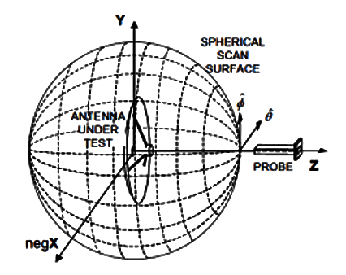
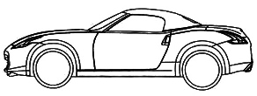
AUT/DUT at Different Positions
Y
Sampling Sphere
Radiation Sphere
Z
ANTENNA
UNDER
TEST
negX
Classic SWE
Sampling Sphere = Radiation Sphere
Sampling Sphere ≠ Radiation Sphere

Slide 10




MPAC Solution for Automotive MIMO testing
ESTIMATED NUMBER OF PROBES*
Up Link
AUT
Frequency | Small car | Large truck
410MHz | 49 | 68
7.125GHz | 851 | 1178
Down Link
Mobile Phone
Module
Turntable Pit
* M. Berbeci, P. Pelland and T. Leifert, "Challenges for the Automotive Industry on MIMO OTA Testing," 2020 Antenna Measurement Techniques Association Symposium (AMTA), Newport, RI, USA, 2020, pp. 1-5.
Fiber
-
Optic
Interface Unit
Limited
Amplifier
V
H
V
H
TX
V
RX
1
H
TX
Splitters
V
Base Station
H
Pre
-
amplifier
Emulator
TX
MT
8821
C
2
Spirent Virtex
Channel Emulator
Position Controller
USB
-
GPIB
PC
TY
2100
MO
MIMO OTA Measurement Software
Notes:
Features:
Intuitive, theoretically correct
The actual error is large, the cost is high, and the system is complicated
According to the 3GPP standard document submitted by Huawei in 2018, the difference in test results of the same DUT among the three multi-probe laboratories with the same setup is as high as 7.31dB
a significantly larger test zone would be required if the MPAC approach was to be used for automotive testing. As the size of the DUT increases, the test zone increases which in turn means that the overall size of the chamber and number of probes will grow. Table I. gives estimates of the number of probes required in a single angular dimension (e.g. ϕ) for a small (4.5m x 1.8m) and large (6.4m x 2.0m) vehicle at the lowest and highest frequencies of 5G FR1. Even at the lowest frequencies for 5G operation, the number of test probes is quite large. At the highest frequency for FR1, the number of probes becomes physically unrealizable, not to mention financially prohibitive. Scaling this to larger vehicles like commercial passenger busses or considering 5G FR2 (24 – 53 GHz) further exacerbates the issue. While this method is technically robust, the application of an MPAC to automotive testing appears to be untenable for both 4G and 5G tests.

Slide 11

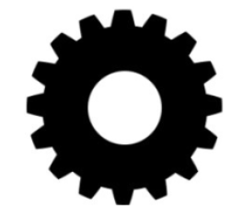
Radiated Two Stage (RTS) Theory
Target:
trans1 signals only be sent to recv1，
trans2 signals only be sent to recv2
Result:
trans1 signals only be sent to recv1，
trans2 signals only be sent to recv2
Base Station
Emulator (BSE)
Channel
Emulator
Recv1
Recv2
Antenna patterns
Inverse Matrix M
Calibration Matrix A
Equal To
directly connect
2x2 MIMO test steps:
Antenna patterns measurement
OTA Throughput Measurement
directly connect
Notes:
The TX1 to RX1, the received signal of Recv1 is the sum of the two signals.
The TX1 to RX2, the received signal of Recv2 is the also sum of the two signals. If we adjust the matrix M to let the two signal have the same amplitude and opposite phase, the received signal of Recv2 from TX1 will be zero, the virtual cable 1 is realized. The virtual cable 2 is the same process as 1.
After adjusting the matrix M, the virtual cables are realized, and the TX1 is only sent to Recv1 and the TX2 is only sent to Recv2.

Slide 12

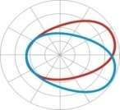

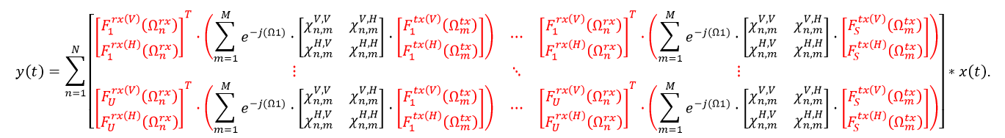
Radiated Two Stage Method – Patented Technology
RTS based MIMO OTA test solution for ICV is the only realistic technique available today
Features:
  Theoretically correct, international standards
  Small error, stable, cost-effective, simple system
Channel
Emulator

Slide 13
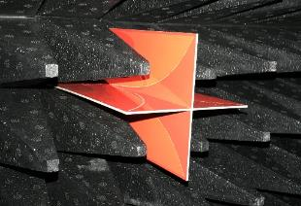
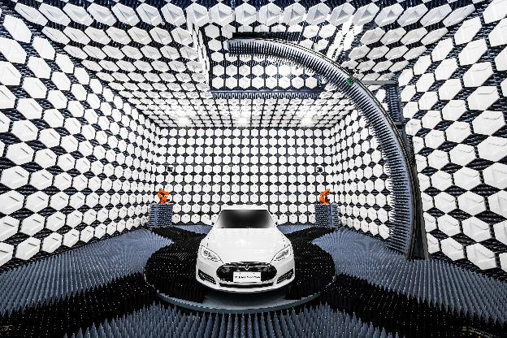


Total Solution for Automotive OTA Testing from test algorithm to software platform, from key component to whole system
MIMO OTA Sub-Working Group Certification Program Working Group (CPWG) Contribution
Contribution Number | MOSG200405
Contributor's Name (Company Name) | Thorsten Hertel, Ya Jing (Keysight Technologies), Yihong Qi, Wei Yu (General Test Systems), Pat Connor (Qualcomm Incorporated), Jose M. Fortes (Rohde & Schwarz)
Contribution Date | May 19, 2020
Contribution Type | (P) Proposal
Contribution Intent | (E) Endorsement
Contribution Title | On including RTS into the MIMO OTA Test Plan
CTIA Certification Program Working Group Contribution
Contribution Number | MOSG171204
Contributor's Name | Moray Rumney (Keysight Technologies), Thorsten Hertel (Rohde & Schwarz), Penghui Shen (GTS)
Contribution Date | December 3, 2017
Contribution Topic | Inclusion of RTS into MIMO OTA test plan
2021 "Temperature Effects in OTA MIMO Measurement," in IEEE Transactions
2020 "Inverse Matrix Autosearch Technique for the RTS MIMO OTA Test," in IEEE Transactions
2020 "A 2×2 MIMO Throughput Analytical Model for RF Front End Optimization," in Journal of Communications and Information Networks,
2020 "3-D Printing Conformal K-Band Lens Antenna for a Smart Parking Space Detection System," in IEEE Transactions
2020 "Rugged Linear Array for IoT Applications," in IEEE Internet of Things Journal
2020 "Calibration Loop Antenna for Multiple Probe Antenna Measurement System," in IEEE Transactions
2020 "Review of the EMC Aspects of Internet of Things," in IEEE Transactions
2020 "Total Isotropic Sensitivity Measurement in Switched Beam Antenna Systems," in IEEE Transactions
2020 "Small Anechoic Chamber Design Method for On-Line and On-Site Passive Intermodulation Measurement," in IEEE Transactions
2019 "Directional Antenna With Consistent H-Plane Dual-Band Beamwidth for Wi-Fi Applications," in IEEE Transactions
2019 "An RTS-Based Near-Field MIMO Measurement Solution—A Step Toward 5G," in IEEE Transactions
2019 "OTA Measurement for IoT Wireless Device Performance Evaluation: Challenges and Solutions," in IEEE IoT Journal,
2018 "Dual-Band Directional Slot Antenna for Wi-Fi Application," in IEEE Transactions
2018 "A Decomposition Method for MIMO OTA Performance Evaluation," in IEEE Transactions on Vehicular Technology
2018 "Horizontally Polarized Antenna for Calibration of a Multiple Probe Antennas Measurement System," in IEEE Transactions
2018 "An Equivalent Circuit Model to Analyze Passive Intermodulation of Loose Contact Coaxial Connectors," in IEEE Transactions
We hold 150+ patents, and published 280 papers on Antenna noise temperature, NF-FF transformation, Fast sensitivity measurements, RTS and Absorbers

Slide 14





Challenges of Automotive OTA Measurement
  Large size DUT
  Direct far field measurement becomes difficult.
Spherical near field sampling
+
Near field to far field transformation
  Eccentricity issue
  If conventional Spherical Wave Expansion method cannot solve the eccentricity then test error is large
    Customized Test Probe + 3D calibration
    Wide probe beam width (beam is required to cover the entire DUT)
    Low Cross polarization ratio (Cross polarization at a wide angle)
    High Probe beam symmetry
    Calibration of the 3D pattern of the probe in the NF-FF transformations
  SISO test
  How to perform EIRP and EIS test in near field
  Optimized NF-FF transformation algorithm
  Antenna aperture coupling theory based EIRP/EIS test
  MIMO Throughput Test
    Rebuild a real-world transmission channel in an anechoic
    chamber
  MIMO Throughput Test
    Radiated Two Stage (RTS) MIMO method

Slide 15
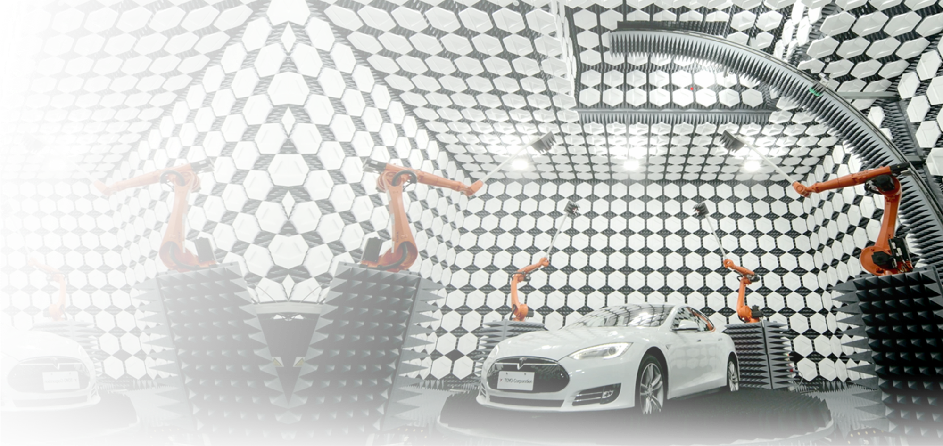
Next-Gen Full-Vehicle OTA Testing Solutions
Arc + Arms Solution | Multiple probes are fixed using electrical switching, and coordinate with the rotation of the vehicle on the turntable to perform 3D wireless performance test | Multiple probes are fixed using electrical switching, and coordinate with the rotation of the vehicle on the turntable to perform 3D wireless performance test
Principle | Spherical near field sampling + NF-FF + RTS MIMO
Speed | Fast
Accuracy | High
Measurable items | 1) Passive measurement 2) ICV SISO 3) ICV MIMO 4X4 measurement (patented) option 4) GPS related OTA test
Arc + Arms Solution

Slide 16
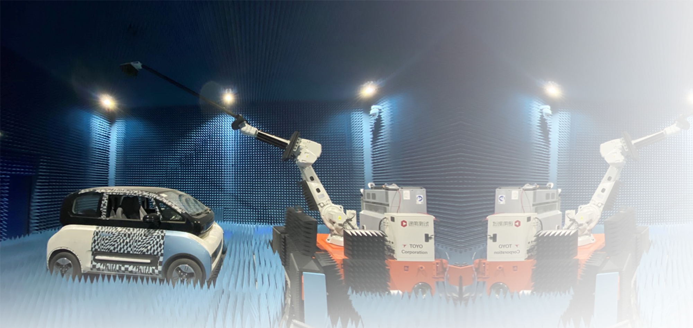
Next-Gen Full-Vehicle OTA Testing Solutions (upgrade)
ROBOT SOLUTION | An antenna is placed at the end of the movable robot and integrates with an EMC turntable to perform 3D wireless performance test – add OTA test functions to an existing EMC chamber | An antenna is placed at the end of the movable robot and integrates with the EMC turntable to perform 3D wireless performance testing
Principle | Spherical near field sampling + NF-FF
Speed | Normal
Accuracy | Normal Mechanical accuracy can match a large chamber, but the accuracy depends on the EMC chamber material
Measurable items | 1) Passive measurements 2) ICV SISO 3) ICV MIMO 2X2 measurement (patented) option 4) EMC test (patented) option
ROBOT Solution

Slide 17

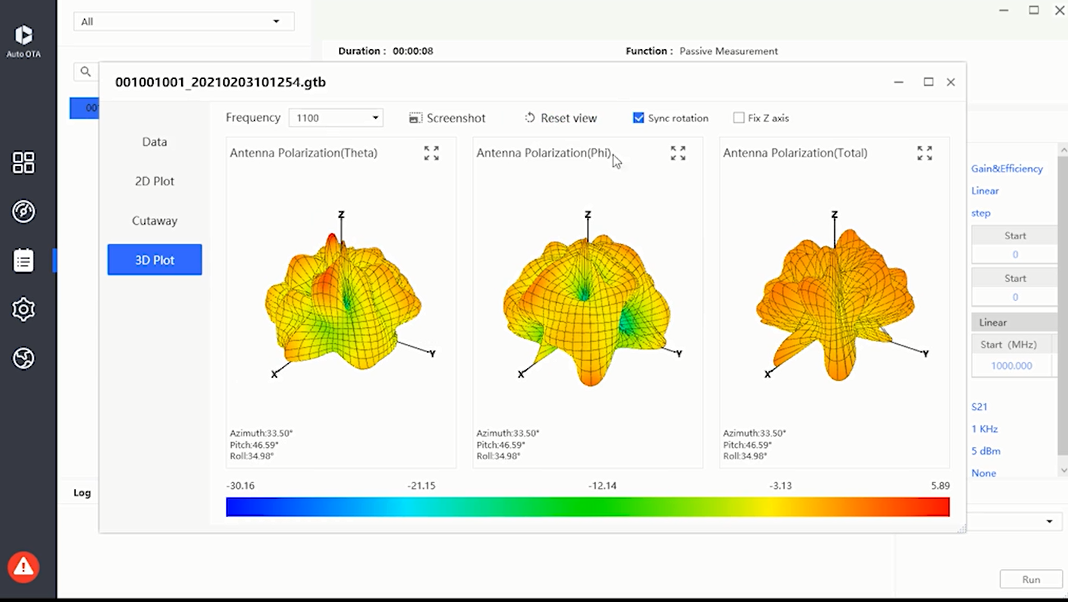
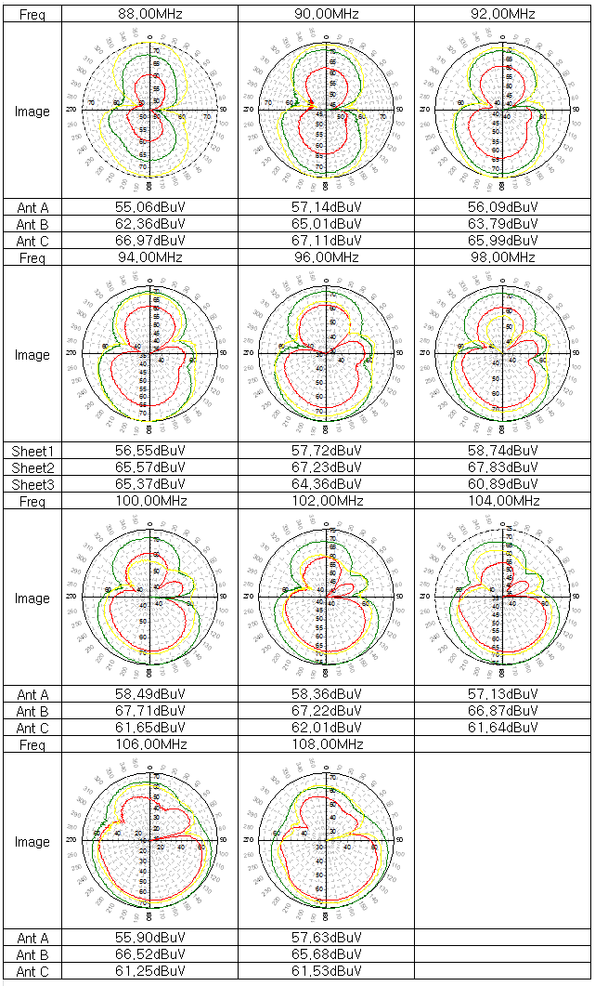
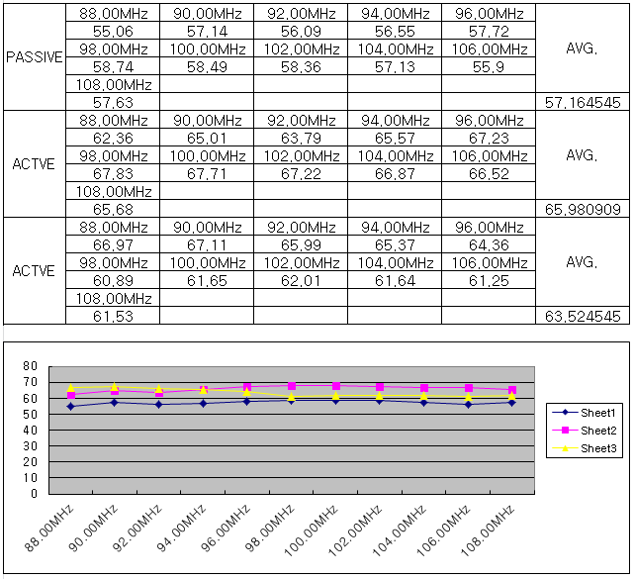
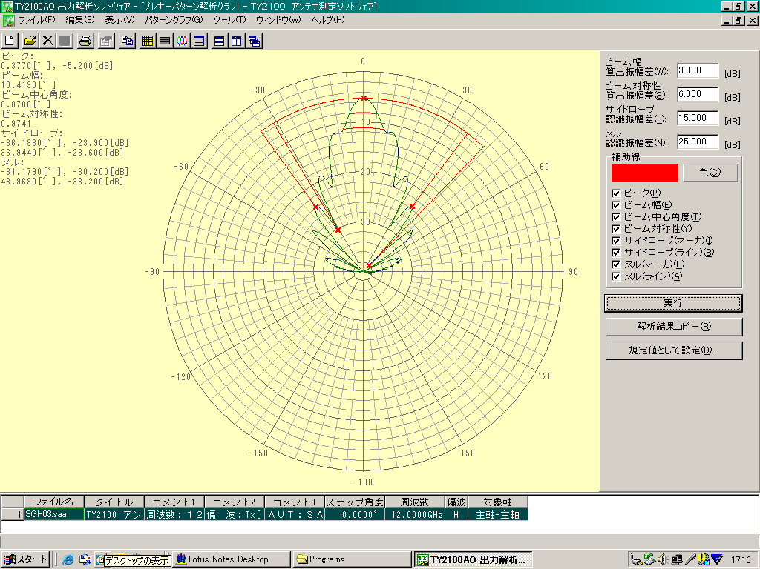
MaxSign_Auto Automatic Test Software

Slide 18
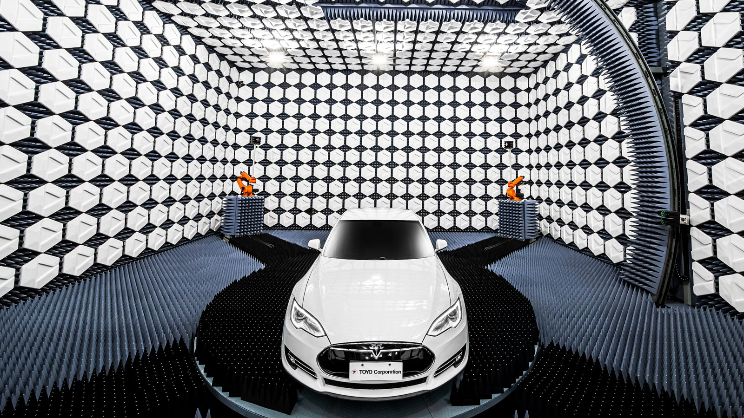




Slide 19
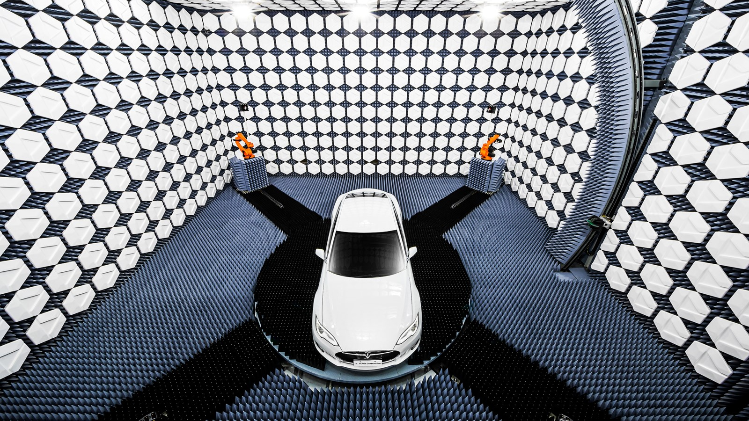
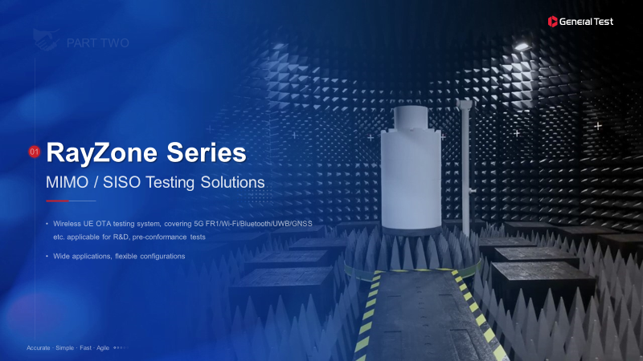
RESOURCES
Web: www.aerogtlabs.com
Linkedin: https://www.linkedin.com/company/aerogt-labs
Video: Next-Gen Automotive OTA Test: https://youtu.be/Gr1hojkvRmE
Contact: info@ aerogtlabs.com

